Slide 1
Credit EDA Case Study
To use Concepts of EDA and decipher which types of Customer defaults on a loan
By: Pratima Rathore

Slide 2
The following data cleansing processes were applied to make the data dependable so that it can provide significant business value by improving Decision Making Process:
Removing columns with duplicate values
We checked if the data set has duplicate values, so that it could be removed.
Handling Single Unique Value
’
We checked if the data set has duplicate values, so that it could be removed.
Handling Null Values
Null Value has been identified and treated according to the needs
Sub setting the Dataset
Since our dataset has 160 columns, we are sub setting the data set to 28 columns for better analysis.

Slide 3
Data Understanding
This dataset has 3 files as explained below:
1. 'application_data.csv' contains all the information of the client at the time of application.
The data is about whether a client has payment difficulties.
2. 'previous_application.csv' contains information about the client’s previous loan data. It contains the data whether the previous application had been Approved, Cancelled, Refused or Unused offer.
3. 'columns_description.csv' is data dictionary which describes the meaning of the variables.

Slide 4
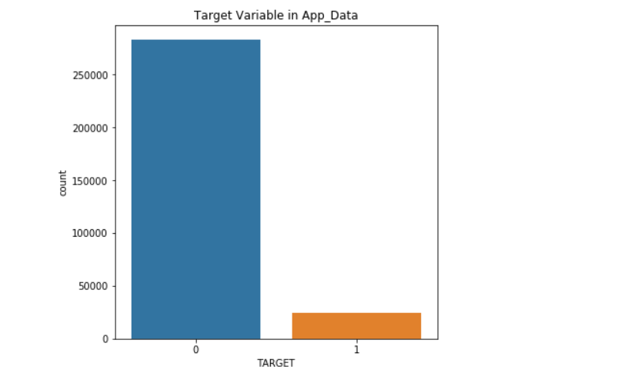
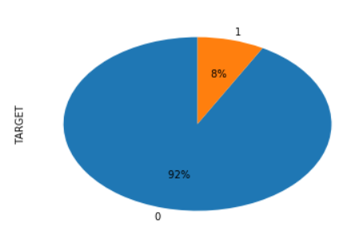
Data Understanding – Non-Defaulter vs Defaulter
Overall Default Rate is 8%

Slide 5
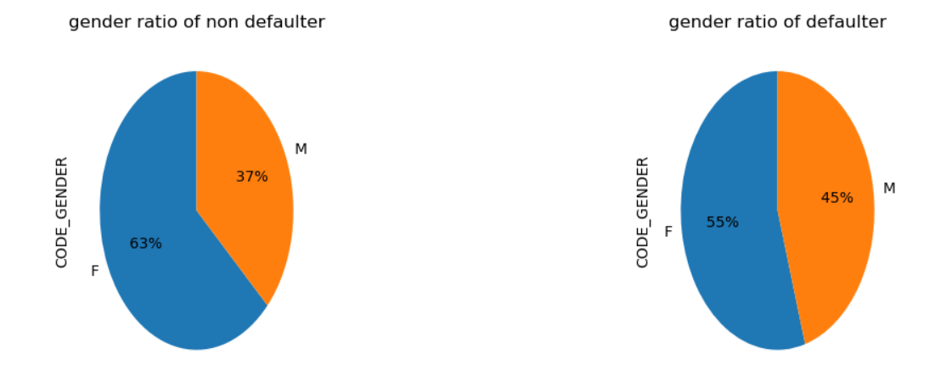
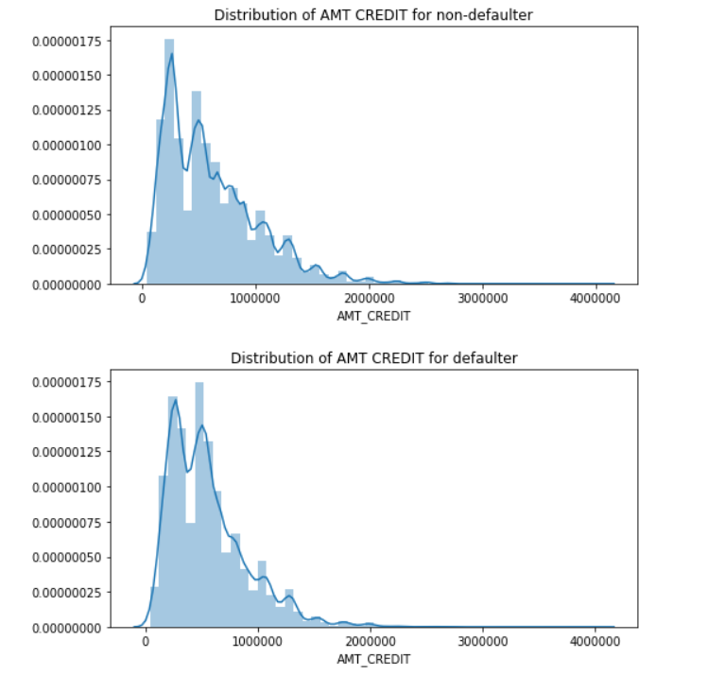
Univariate Analysis
Client gender
Credit distribution
The number of female clients is almost double the number of male clients.
Looking to the percent of defaulter dataset , females have a higher chance of not returning their loans
As we can see the AMT CREDIT is large for the non-defaulters then the defaulters. Meaning candidate with large credit are more likely to pay back

Slide 6
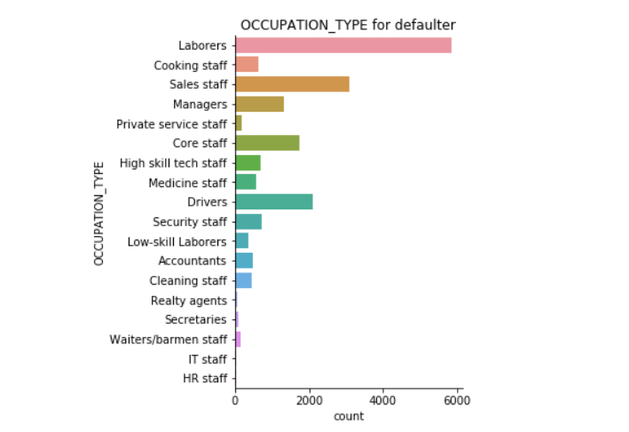
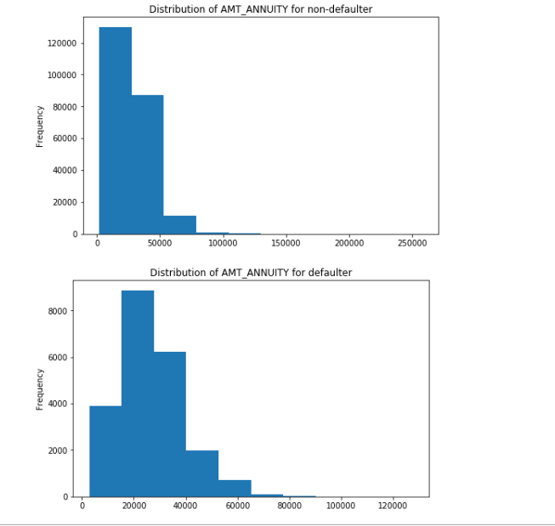
Occupation Type
Annuity distribution
Most of clients belongs to Laborers occupation type who opts for loan, followed by Sales staff and drivers. And least by IT,HR staff and Realty Agents
Most of the non-defaulter clients have higher annuity . So candidate with low annuity are more likely to be defaulter

Slide 7
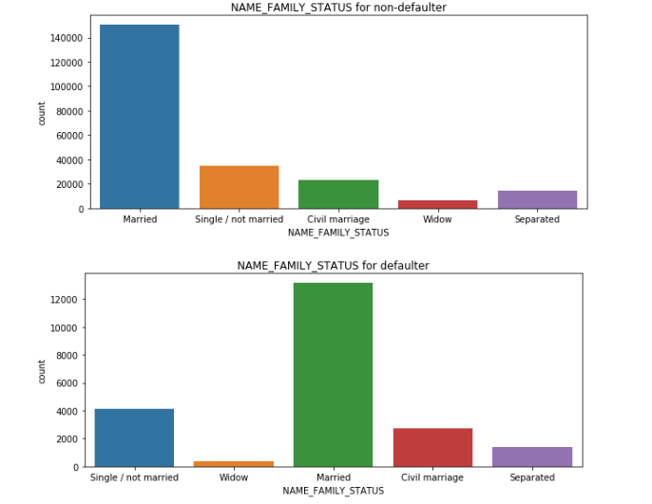
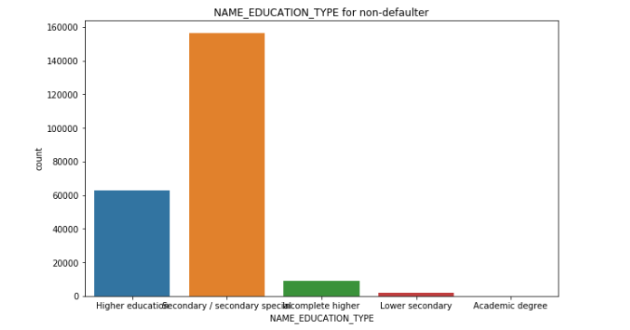
Family status of client
Education type of the client
Married people are more likely to go for loan and least by widow and separated people. Same pattern is followed for defaulter and non-defaulter behaviour
As we can see clients with higher or special secondary education are more likely to opt for loan I contrast with less educated clients

Slide 8
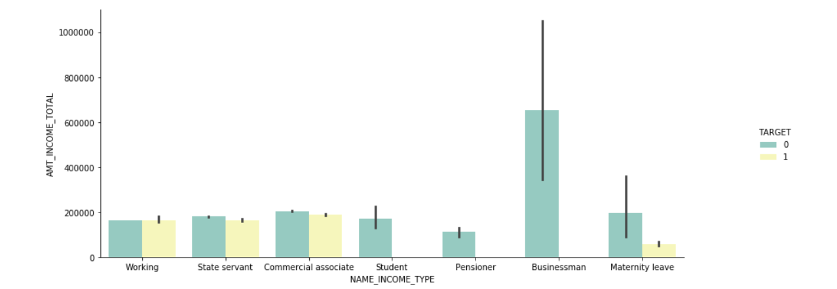
Relation btw Client's Income type and Total Income for non-defaulter and defaulter
Bivariate Analysis
We can see we don’t find Businessman ,students and Pensioner to be defaulter. These Income types are least likely to be defaulter. Whereas Total income don’t follow any such pattern.

Slide 9
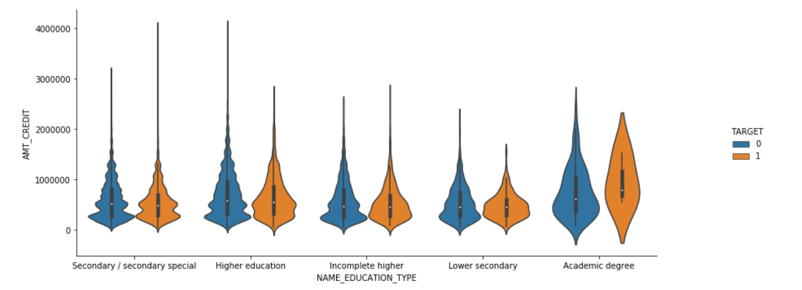
Relation btw Client's Education type and Credit amount towards the repayor and defaulter behavior
We can see, Secondary/secondary special Education followed by Higher education type clients are more likely to go for higher Credit Amount. But we don’t see any significant pattern with being defaulter wrt credit amount or education.

Slide 10
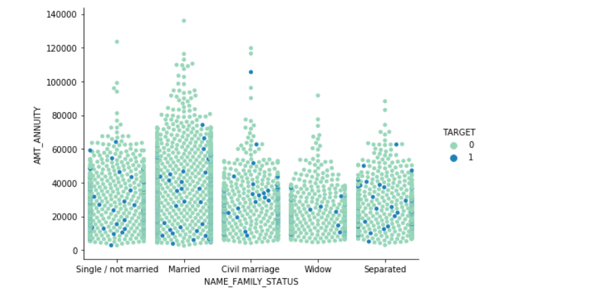
Relation btw Client's Income type and Total Income for non-defaulter and defaulter
We can see Married and Single are more likely to have high Amt Annuity. And as the amount increase , the likeliness of candidate to be defaulter decreases. Candidate are more likely to be defaulter with less Annuity amount.

Slide 11
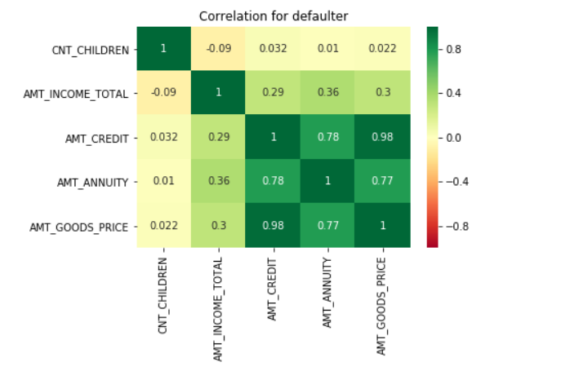
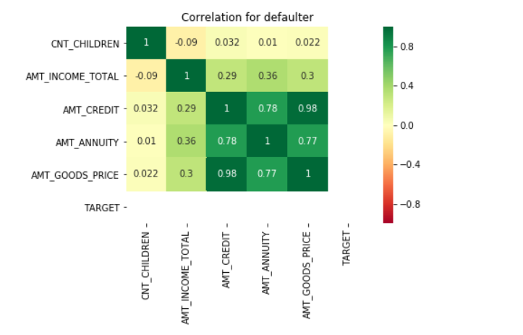
Multivariate Analysis
The below heatmap, shows the correlation between variables from the dataset.

Slide 12
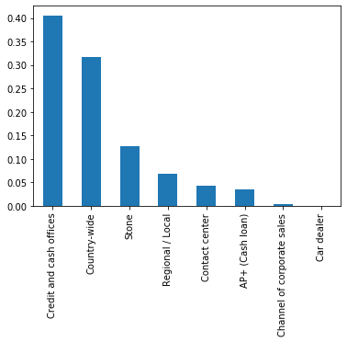
Analysis on Merged data frame for “ Channel Type” column – Univariate Analysis
Description of the CHANNEL_TYPE column say’s "Through which channel we acquired the client on the previous application".
So as we can see from the bar plot, majority of the clients are acquired from "Credit & Cash offices" and lowest clients are acquired from Car dealer.

Slide 13
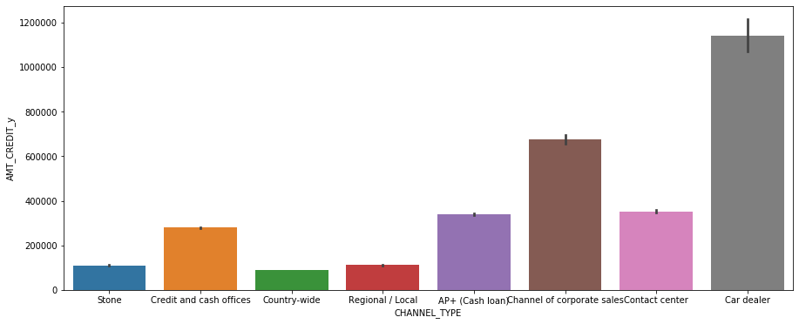
Analysis on Merged data frame for “ Channel Type” column – Bivariate Analysis
Description of the CHANNEL_TYPE column say’s "Through which channel we acquired the client on the previous application".
So as we can see from the bar plot, majority of the clients are acquired from "Credit & Cash offices" and lowest clients are acquired from Car dealer.

Slide 14
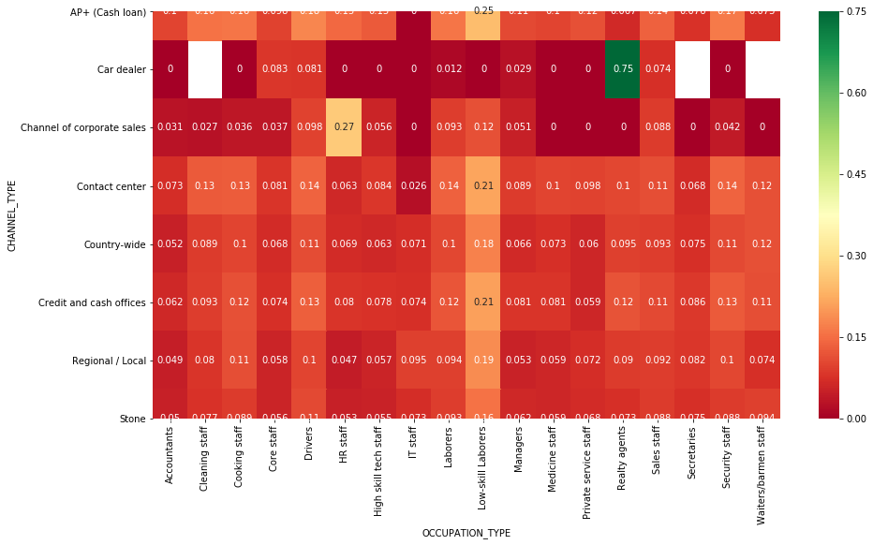
Analysis on Merged data frame for “ Channel Type” column – Multi Analysis
Based on the heat map, it is safe to say "Realty Agents" who are acquired through Car dealer are the biggest defaulter in out loan repayments.

Slide 15
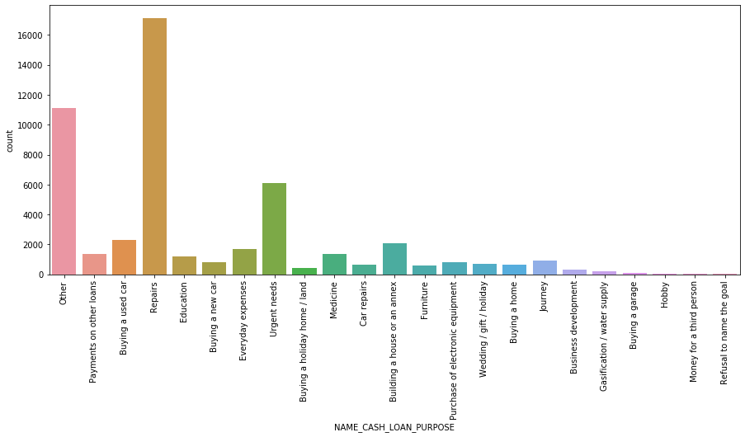
Analysis on Merged data frame for “ Cash Loan Purpose” column – Univariate Analysis
So based on the count plot, we can see Repairs in one of the biggest reason people are applying for loan. While buying a garage & hobby are the smallest purpose of all. But basically we have to find which cash loan purpose among the above gives us the highest defaulter.

Slide 16
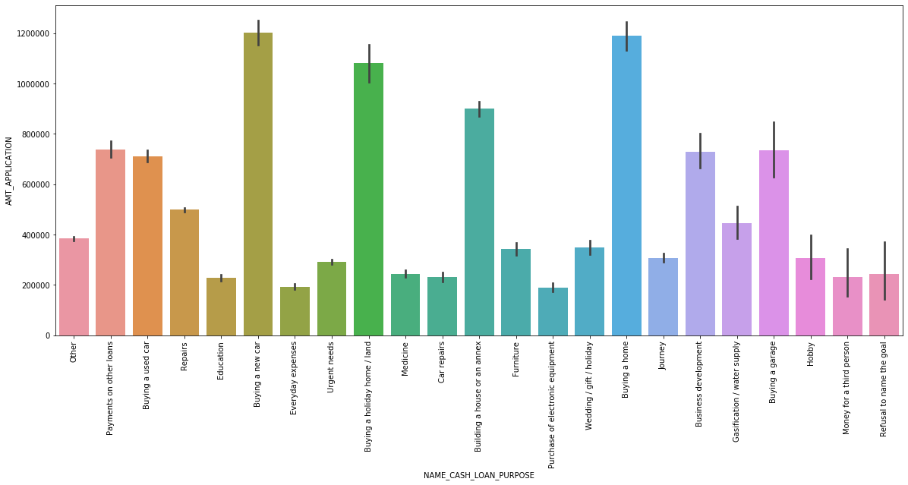
Analysis on Merged data frame for “ Cash Loan Purpose” column – Bivariate Analysis
# Buying a new car & Buying a home even though counts to a small percentage of cash loan purpose
# but they are the purposes for which clients had asked for highest amount.

Slide 17
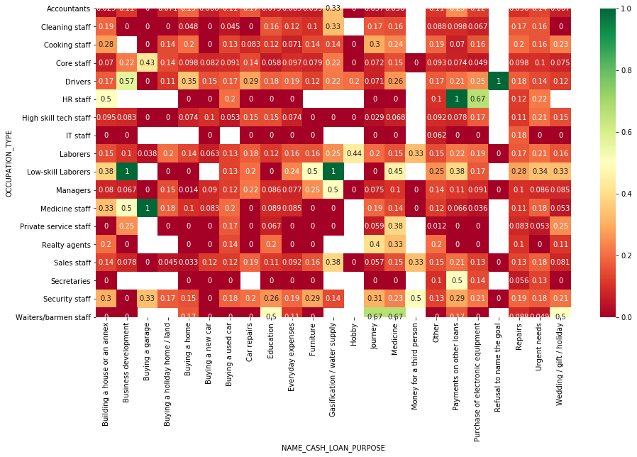
Analysis on Merged data frame for “ Cash Loan Purpose” column – Multivariate Analysis
So based on the above heat map we can safely say that following are the OCCUPATION_TYPE - CASH_LOAN_PURPOSE which are the biggest defaulters:
1. Low skilled laborers who asked for loan for purpose as Business Development.
2. Medicine Staff who asked for loan for purpose as Buying a garage.
3. Low skilled laborers who asked for loan for purpose as Gasification/water suppy.
4. HR staff who asked for loan for purpose as payment of other loan.
5. Driver who asked for loan for purpose as Refusal to the name of loan.

Slide 18
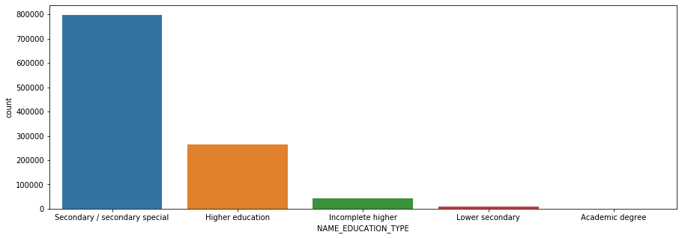
Analysis on Merged data frame for “ Education Type” column – Univariate Analysis
There are 5 types of education, highest being Academic degree but they are the lowest in number.
But Secondary / secondary special are highest in number.

Slide 19
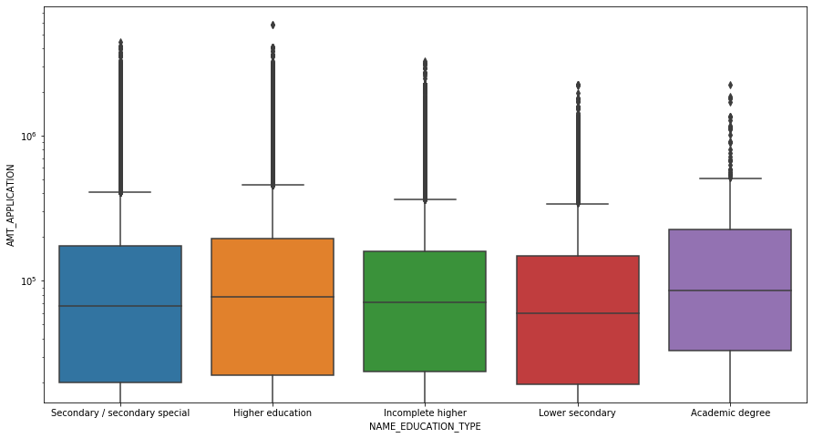
Analysis on Merged data frame for “Education Type” column – Bivariate Analysis
# So we can see from the boxplot irrespective of the education type AMT_APPLICATION i.e. how much credit did client ask on the previous application is always the same.
# It also means, most of the time while providing loan the client, education is not considered considerably.

Slide 20
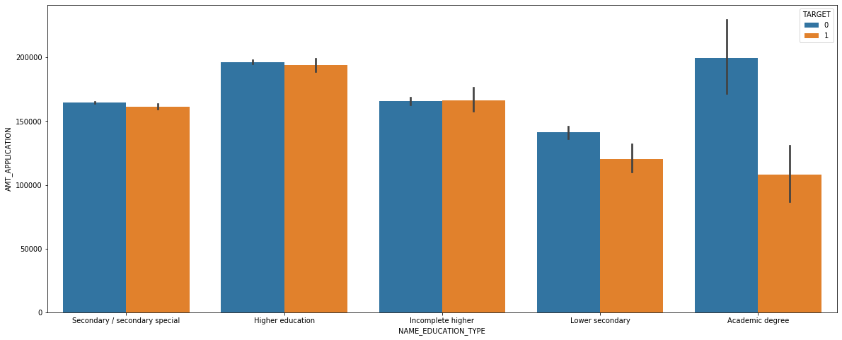
Analysis on Merged data frame for “Education Type” column – Multivariate Analysis
Based on the barplot we can say, the clients who have "ACADEMIC DEGREE" are in a better position to pay the loan back. So Bank should try to offer loan to these clients as they are banks assets

Slide 21
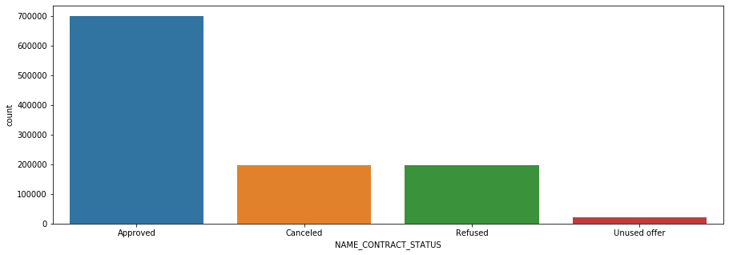
Analysis on Merged data frame for “ Contract Status” column – Univariate Analysis
So as we can see from the countplot, most of the contracts that are coming from clients are gettign approved.

Slide 22
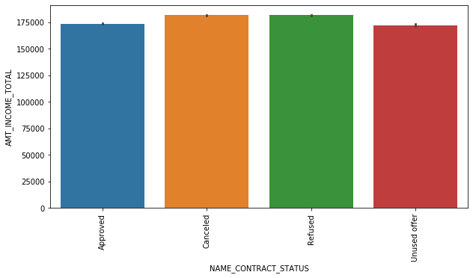
Analysis on Merged data frame for “Contract Status” column – Bivariate Analysis
So, as we can see through the barplot, irrespective of the Income, mostly all the contracts have same total income. This means, while providing loan total income is not taken into consideration much. Ideally it should be considered.

Slide 23
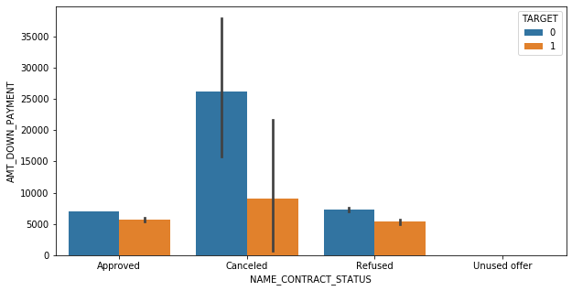
Analysis on Merged data frame for “Contract Status” column – Multivariate Analysis
So we can see from bar plot, for clients who paid higher Down payment in previous application , their contract is getting Cancelled. Who in generally are non defaulter.
So for higher revenue of bank any client who paid higher down payment in previous application their contract should get approved as they are non defaulter.

Slide 24
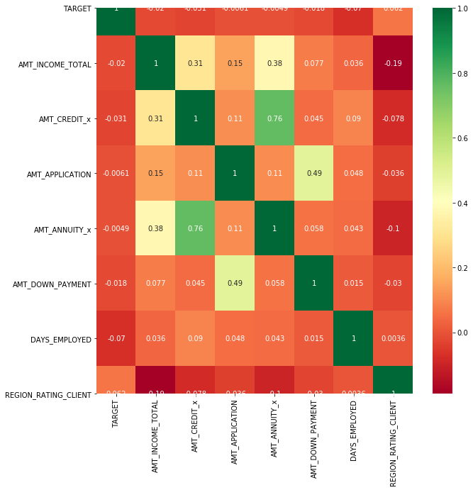
Analysis correlation between variables
So based on above correlation map we can safely say the highest correlation is between AMT_ANNUITY & AMT_CREDIT.

